Slide 1
Branch and Bound
LIFO-BB and FIFO-BB

Slide 2
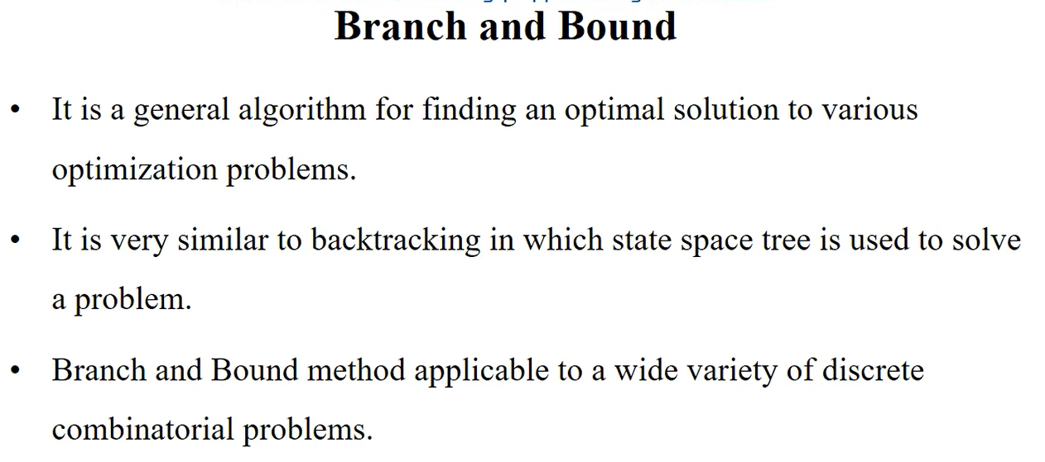

Slide 3
These problems are typically exponential in terms of time complexity and may require exploring all possible permutations in worst case
In backtracking, the state space tree is searched until the solution is obtained.
In Branch-and-Bound as the optimum solution may be present any where in the state space tree, so the tree need to be searched Completely.
Backtracking is more efficient. Branch-and-Bound is less efficient.

Slide 4
The Branch and Bound Technique is a problem solving strategy, which is most commonly used in optimization problems, where the goal is to minimize a certain value.
The optimized solution is obtained by means of a state space tree (A state space tree is a tree where the solution is constructed by adding elements one by one, starting from the root. Note that the root contains no element).
This method is best when used for combinatorial problems with exponential time complexity, since it provides a more efficient solution to such problems.

Slide 5
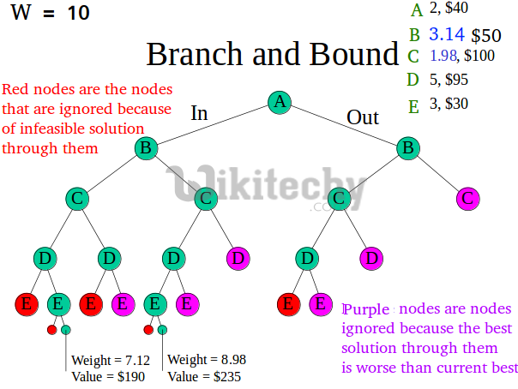

Slide 6
The Algorithm: Branch and Bound Technique
In this technique, the first step is to create a function U (which represents an upper bound to the value that node and its children shall achieve), that we intend to minimize.
We call this function the objective function. Note that the branch and bound technique can also be used for maximization problems, since multiplying the objective function by -1 coverts the problem to a minimization problem.
Let this function have an initial maximum value, according to the conditions of the given problem. Also, let U₀ be the initial value of U. We also calculate a cost function C which will give us the exact value that the particular node shall achieve.

Slide 7
The next question is the order in which the tree is to be searched. For this, there exist multiple types of branch and bound, which we shall discuss in detail later.
For now, let us assume that there is a set S consisting of subsets of the given set of values in the order in which they need to be searched.

Slide 8
When to apply Branch and Bound Algorithm?
Branch and bound is an effective solution to some problems, which we have already discussed. We’ll discuss all such cases where branching and binding are appropriate.
It is appropriate to use a branch and bound approach if the given problem is discrete optimization.
Discrete optimization refers to problems in which the variables belong to the discrete set.
When it comes to combinatory optimization problems, branch and bound work well.
An optimization problem is optimized by combinatory optimization by finding its maximum or minimum based on its objective function.
The combinatory optimization problems include Boolean Satisfiability and Integer Linear Programming.

Slide 9
Types of Branch and Bound Solutions:
The solution of the Branch and the bound problem can be represented in two ways:
Variable size solution:
Using this solution, we can find the subset of the given set that gives the optimized solution to the given problem.
For example, if we have to select a combination of elements from {A, B, C, D} that optimizes the given problem, and it is found that A and B together give the best solution, then the solution will be {A, B}.
Fixed-size solution:
There are 0s and 1s in this solution, with the digit at the ith position indicating whether the ith element should be included,
for the above example, the solution will be given by {1, 1, 0, 0}, here 1 represent that we have select the element which at ith position and 0 represent we don’t select the element at ith position.

Slide 10
Classification of Branch and Bound Problems:
The Branch and Bound method can be classified into three types based on the order in which the state space tree is searched.
FIFO Branch and Bound
LIFO Branch and Bound
Least Cost-Branch and Bound
We will now discuss each of these methods in more detail. To denote the solutions in these methods, we will use the variable solution method.

Slide 11
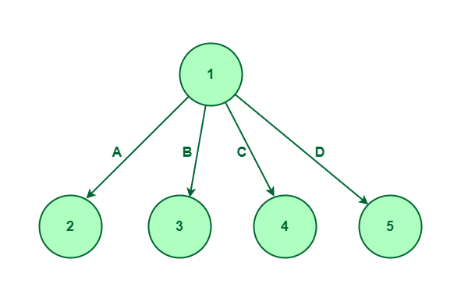
FIFO Branch and Bound
First-In-First-Out is an approach to the branch and bound problem that uses the queue approach to create a state-space tree.
In this case, the breadth-first search is performed, that is, the elements at a certain level are all searched, and then the elements at the next level are searched, starting with the first child of the first node at the previous level.
For a given set {A, B, C, D}, the state space tree will be constructed as follows :
The diagram shows that we first consider element A, then element B, then element C and finally we’ll consider the last element which is D. We are performing BFS while exploring the nodes.

Slide 12
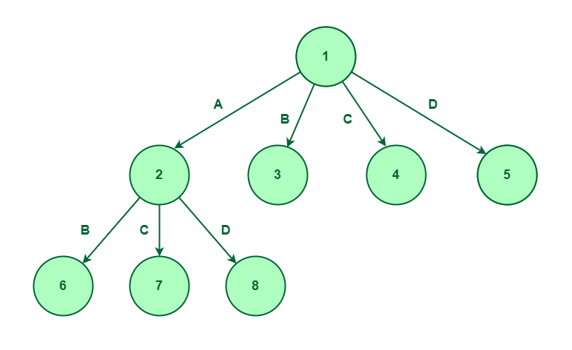
So, once the first level is completed. We’ll consider the first element, then we can consider either B, C, or D.
If we follow the route then it says that we are doing elements A and D so we will not consider elements B and C.
If we select the elements A and D only, then it says that we are selecting elements A and D and we are not considering elements B and C.

Slide 13
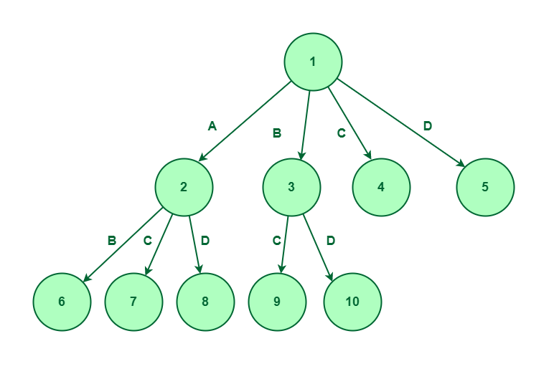
Now, we will expand node 3, as we have considered element B and not considered element A, so, we have two options to explore that is elements C and D. Let’s create nodes 9 and 10 for elements C and D respectively.

Slide 14
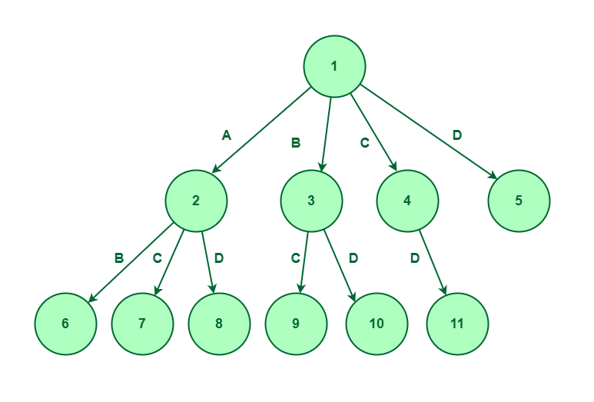
Now, we will expand node 4 as we have only considered elements C and not considered elements A and B, so, we have only one option to explore which is element D. Let’s create node 11 for D.
Considered elements C and not considered elements A and B

Slide 15
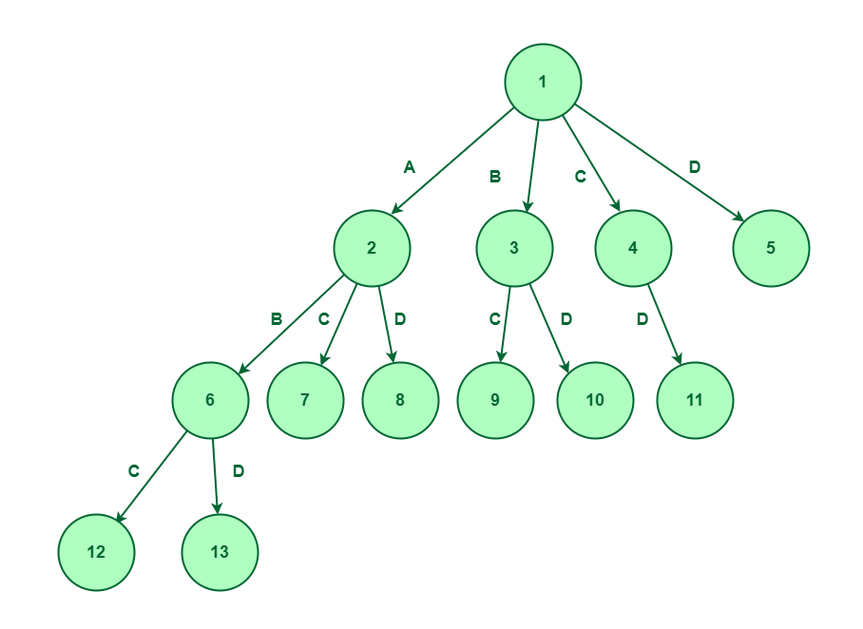
Till node 5, we have only considered elements D, and not selected elements A, B, and C. So, We have no more elements to explore, Therefore on node 5, there won’t be any expansion.
Now, we will expand node 6 as we have considered elements A and B, so, we have only two option to explore that is element C and D. Let’s create node 12 and 13 for C and D respectively.
Expand node 6

Slide 16
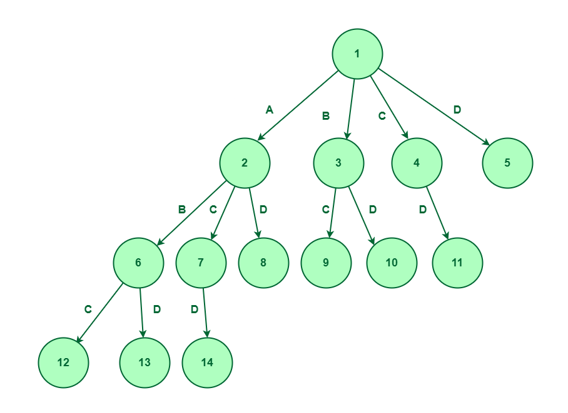
Now, we will expand node 7 as we have considered elements A and C and not consider element B, so, we have only one option to explore which is element D. Let’s create node 14 for D.
Expand node 7

Slide 17
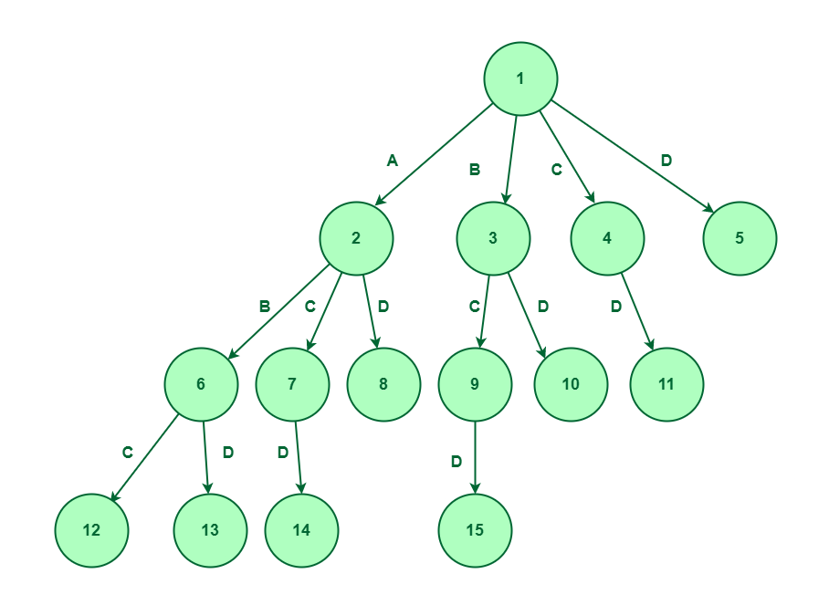
ill node 8, we have considered elements A and D, and not selected elements B and C, So, We have no more elements to explore, Therefore on node 8, there won’t be any expansion.
Now, we will expand node 9 as we have considered elements B and C and not considered element A, so, we have only one option to explore which is element D. Let’s create node 15 for D.
Expand node 9

Slide 18
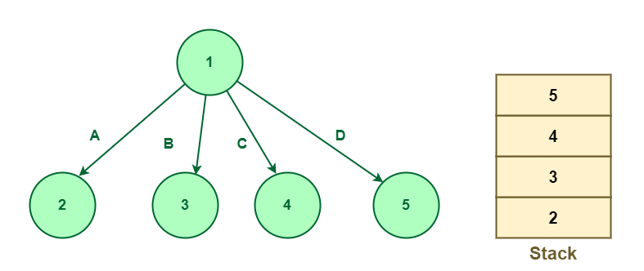
2. LIFO Branch and Bound
The Last-In-First-Out approach for this problem uses stack in creating the state space tree. When nodes are added to a state space tree, they are added to a stack.
After all nodes of a level have been added, we pop the topmost element from the stack and explore it.
For a given set {A, B, C, D}, the state space tree will be constructed as follows :
State space tree for element {A, B, C, D}

Slide 19
Now the expansion would be based on the node that appears on the top of the stack.
Since node 5 appears on the top of the stack, so we will expand node 5.
We will pop out node 5 from the stack. Since node 5 is in the last element, i.e., D so there is no further scope for expansion.
The next node that appears on the top of the stack is node 4. Pop-out node 4 and expand.
On expansion, element D will be considered and node 6 will be added to the stack shown below:

Slide 20
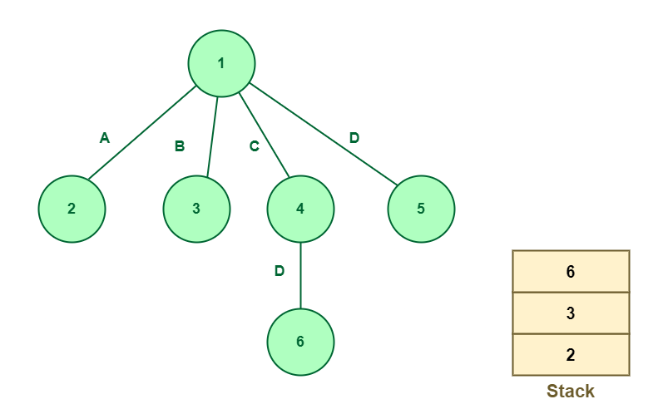
Expand node 4

Slide 21
The next node is 6 which is to be expanded. Pop-out node 6 and expand.
Since node 6 is in the last element, i.e., D so there is no further scope for expansion.
The next node to be expanded is node 3. Since node 3 works on element B so node 3 will be expanded to two nodes, i.e., 7 and 8 working on elements C and D respectively.
Nodes 7 and 8 will be pushed into the stack.
The next node that appears on the top of the stack is node 8. Pop-out node 8 and expand.
Since node 8 works on element D so there is no further scope for the expansion.

Slide 22
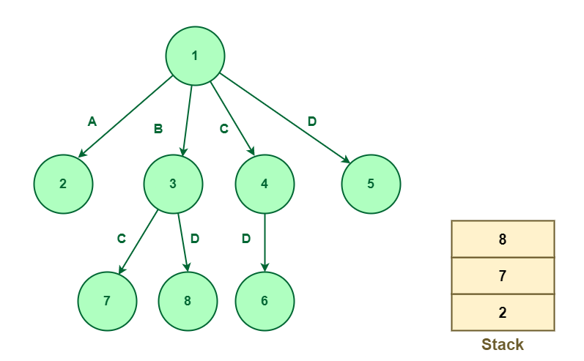
Expand node 3

Slide 23
The next node that appears on the top of the stack is node 7. Pop-out node 7 and expand.
Since node 7 works on element C so node 7 will be further expanded to node 9 which works on element D and node 9 will be pushed into the stack.

Slide 24
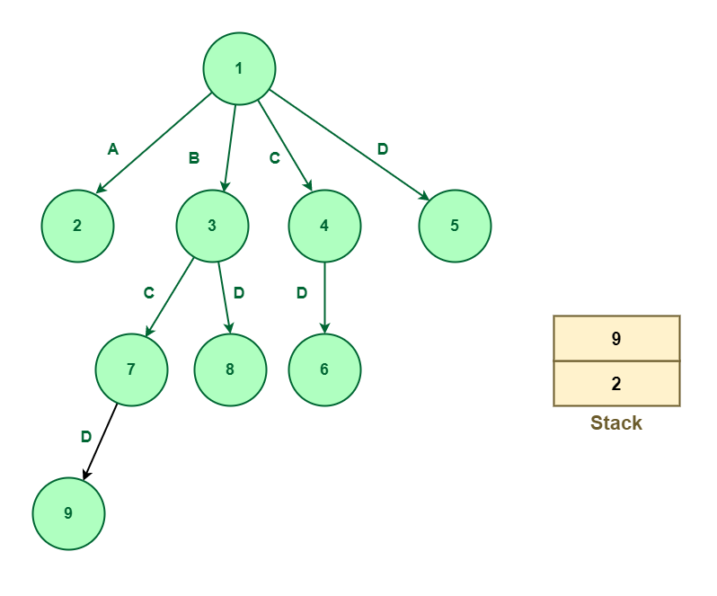
Expand node 7

Slide 25
The next node that appears on the top of the stack is node 9.
Since node 9 works on element D, there is no further scope for expansion.
The next node that appears on the top of the stack is node 2.
Since node 2 works on the element A so it means that node 2 can be further expanded.
It can be expanded up to three nodes named 10, 11, 12 working on elements B, C, and D respectively.
There new nodes will be pushed into the stack shown as below:

Slide 26
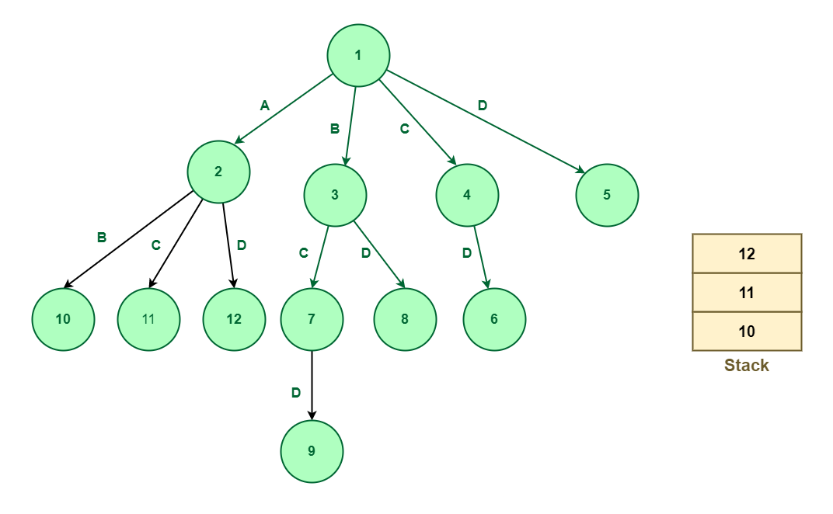
In the above method, we explored all the nodes using the stack that follows the LIFO principle.
Expand node 2

Slide 27
3. Least Cost-Branch and Bound
To explore the state space tree, this method uses the cost function.
The previous two methods also calculate the cost function at each node but the cost is not been used for further exploration.
In this technique, nodes are explored based on their costs, the cost of the node can be defined using the problem and with the help of the given problem, we can define the cost function.
Once the cost function is defined, we can define the cost of the node.

Slide 28
Now, Consider a node whose cost has been determined. If this value is greater than U₀, this node or its children will not be able to give a solution.
As a result, we can kill this node and not explore its further branches.
As a result, this method prevents us from exploring cases that are not worth it, which makes it more efficient for us.

Slide 29
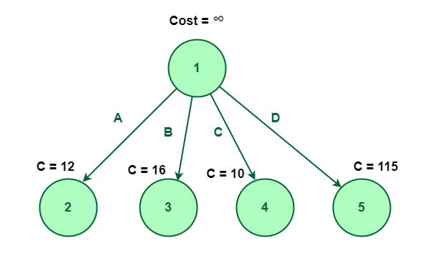
Let’s first consider node 1 having cost infinity shown below:
In the following diagram, node 1 is expanded into four nodes named 2, 3, 4, and 5.
Node 1 is expanded into four nodes named 2, 3, 4, and 5

Slide 30
Assume that cost of the nodes 2, 3, 4, and 5 are 12, 16, 10, and 115 respectively.
In this method, we will explore the node which is having the least cost.
In the above figure, we can observe that the node with a minimum cost is node 4. So, we will explore node 4 having a cost of 10.
During exploring node 4 which is element C, we can notice that there is only one possible element that remains unexplored which is D (i.e, we already decided not to select elements A, and B).
So, it will get expanded to one single element D, let’s say this node number is 6.

Slide 31
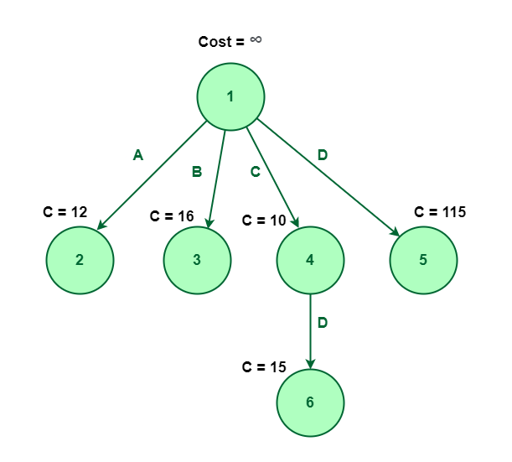
Now, Node 6 has no element left to explore. So, there is no further scope for expansion. Hence the element {C, D} is the optimal way to choose for the least cost.
Exploring node 4 which is element C

Slide 32
Advantages of Branch and Bound Algorithm:
We don’t explore all the nodes in a branch and bound algorithm.
Due to this, the branch and the bound algorithm have a lower time complexity than other algorithms.
Whenever the problem is small and the branching can be completed in a reasonable amount of time, the algorithm finds an optimal solution.
By using the branch and bound algorithm, the optimal solution is reached in a minimal amount of time.
When exploring a tree, it does not repeat nodes.

Slide 33
Disadvantages of Branch and Bound Algorithm:
It takes a long time to run the branch and bound algorithm.
In the worst-case scenario, the number of nodes in the tree may be too large based on the size of the problem.

